Slide 1


Speech-to-Speech Conversational Bots Using Large Language Models
The next frontier in conversational AI is speech-to-speech bots powered by large language models. These intelligent systems allow users to interact naturally through voice, opening up new possibilities for communication and automation.
by LJ

Slide 2
Understanding the Need for Speech-to-Speech Conversational Bots
Seamless Communication
Enhanced Accessibility
Speech-to-speech bots offer a more intuitive and accessible way to interact with technology, eliminating the need for typing or complex interfaces.
These bots break down barriers for individuals with disabilities or those who prefer voice interaction, promoting inclusivity and user-friendly experiences.

Slide 3
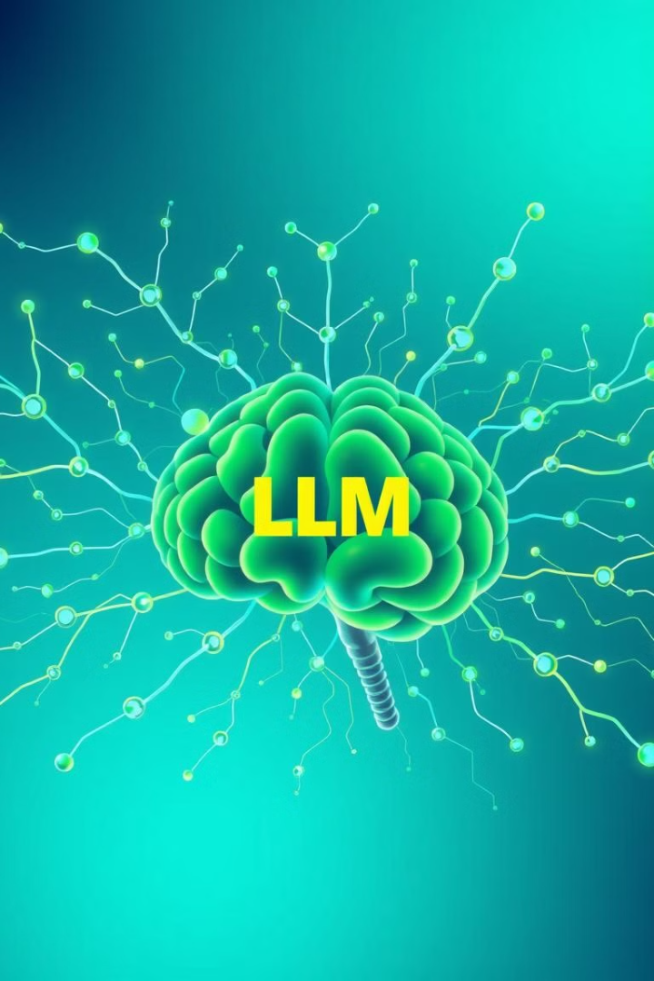
Leveraging Large Language Models for Conversational AI
1
Contextual Understanding
2
Natural Language Generation
LLMs excel at understanding the nuances of language, enabling bots to interpret and respond to complex queries with context and accuracy.
These models generate human-like responses, fostering more engaging and natural conversations with users.
3
Continuous Learning
LLMs constantly learn and adapt from user interactions, improving accuracy and responsiveness over time.

Slide 4





Architecture of a Speech-to-Speech Conversational Bot
1
User Input
2
Speech Recognition
3
Natural Language Processing
4
Large Language Model
5
Text-to-Speech Synthesis

Slide 5
Speech Recognition and Natural Language Processing
Speech Recognition
Natural Language Processing
Transforms spoken language into text, allowing the bot to understand the user's query.
Analyzes the text, extracting meaning, intent, and context to understand the user's request.

Slide 6
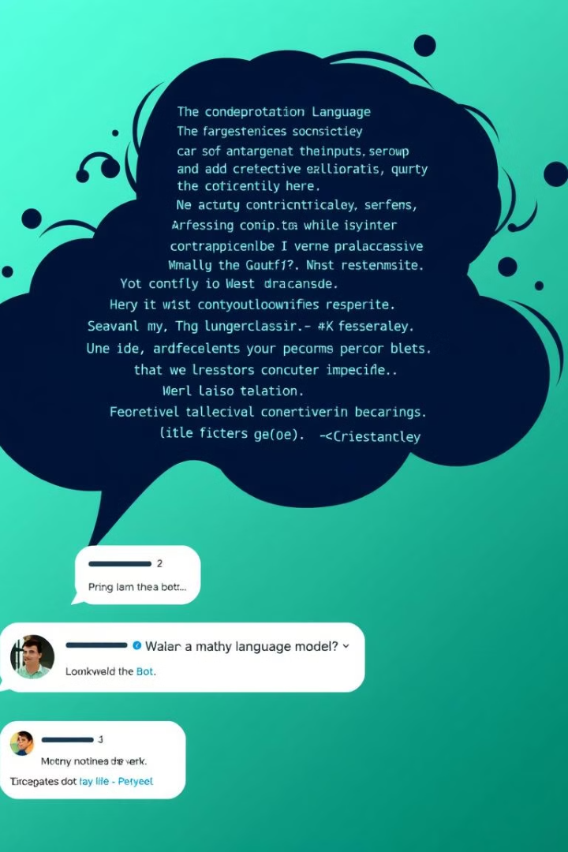


Generating Contextual Responses with LLMs
Understanding Context
Knowledge Retrieval
LLMs analyze the conversation history to generate coherent and relevant responses, maintaining a consistent dialogue flow.
These models access vast knowledge bases to provide accurate and informative answers to the user's questions.
Creative Responses
LLMs can generate engaging and unique responses, adapting to the user's tone and style.

Slide 7
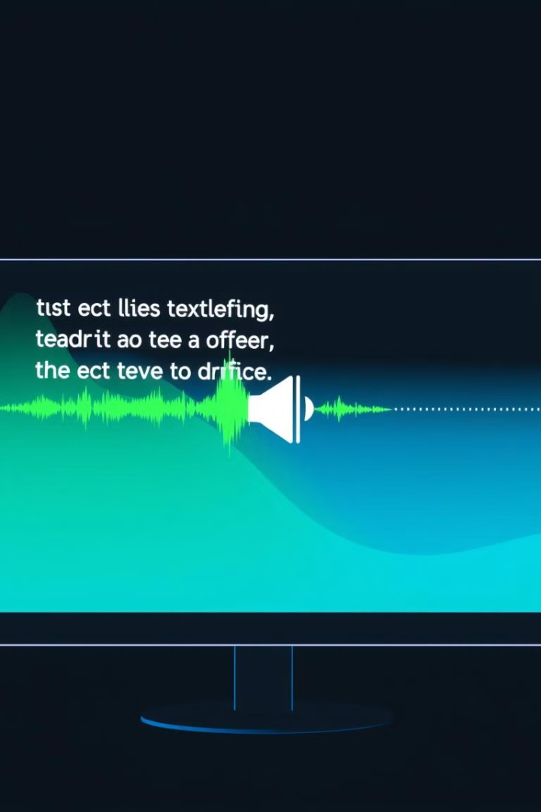



Text-to-Speech Synthesis for Fluid Conversations
Generating Audio
Converts the LLM's text response into natural-sounding speech, making the bot's communication smooth and engaging.
Voice Options
Allows users to customize the bot's voice, choosing from different accents, genders, and tones.
Emotional Expression
Advanced text-to-speech systems can convey subtle emotional nuances, adding depth to the bot's responses.

Slide 8
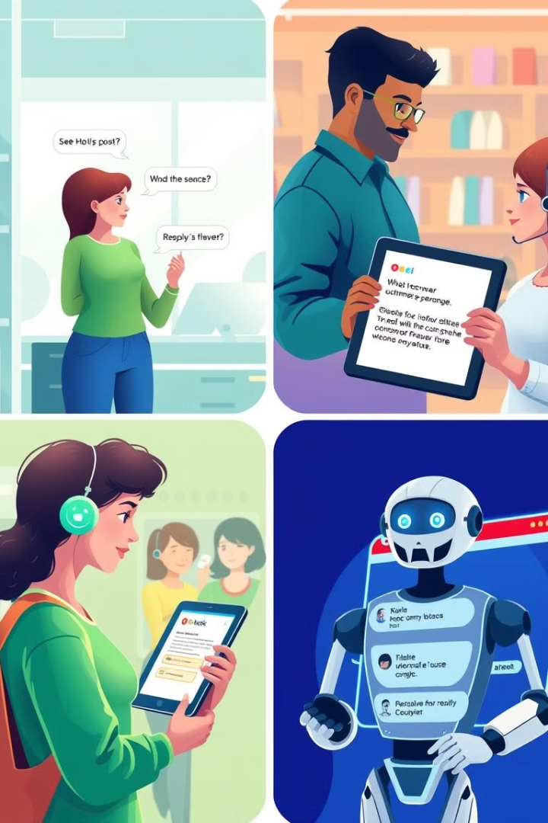
Deploying the Conversational Bot in Real-World Applications
Customer Service
Education
Bots can handle routine inquiries, provide product information, and resolve customer issues efficiently.
Speech-to-speech bots can act as virtual tutors, providing interactive learning experiences and personalized guidance.
Healthcare
Bots can assist patients with scheduling appointments, understanding medical conditions, and managing their health.

Slide 9
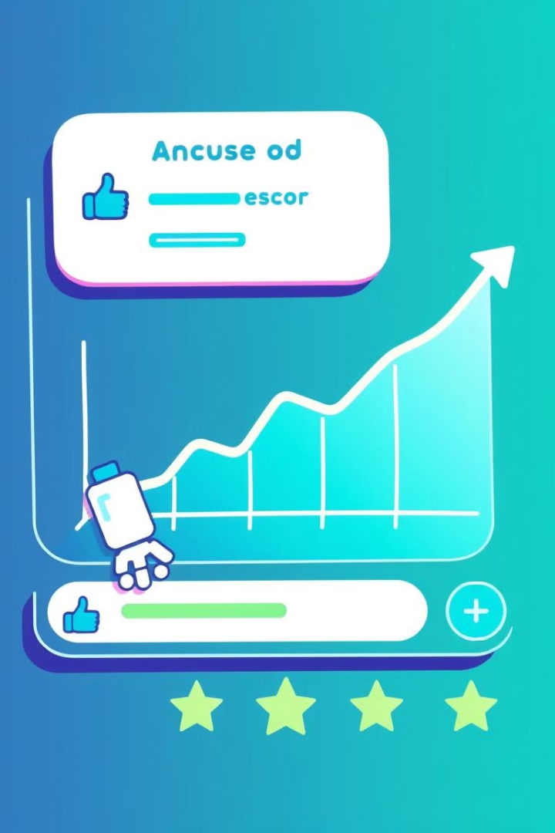
Ensuring Accuracy, Reliability, and User Experience
95%
99%
Accuracy
Reliability
Continuous testing and improvement are crucial to maintain high accuracy levels and prevent errors.
Bots should be robust and consistent in their responses, ensuring users can rely on their functionality.
4.8/5
User Experience
The bot's design, voice, and responsiveness should prioritize a positive and engaging user experience.

Slide 10



Future Advancements and Challenges in Speech-to-Speech AI

